Slide 1


Slide 2
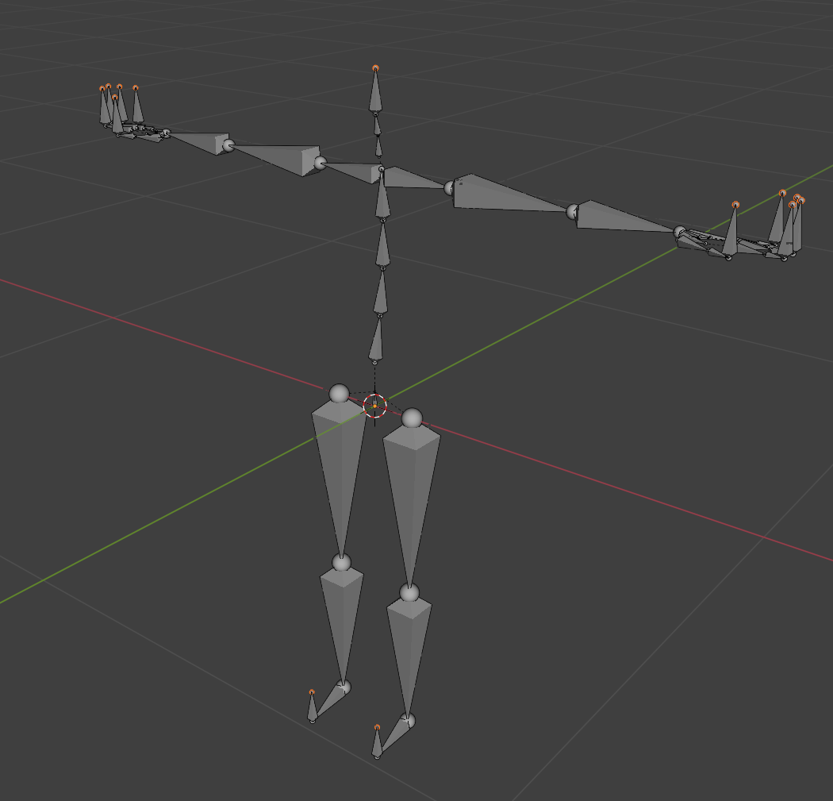
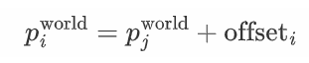
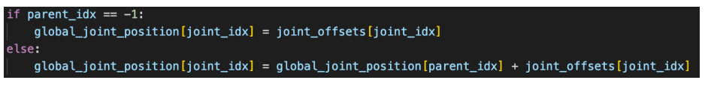
Review on Assignment 1 (part 1)
Joint j
Joint i
“Edit Mode” of an armature in blender

Slide 3

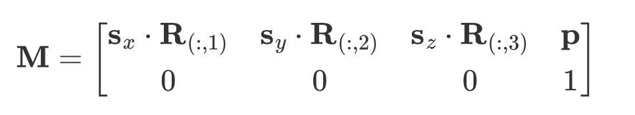
Review on Assignment 1 (part 2)
Review homogeneous transform matrix
Compose a homogeneous transform matrix by translation, rotation and scale
Through the order of scale, rotate and translate, we can write the transform matrix as follows:

Slide 4

Review on Assignment 1 (part 2)
Understand “local transformation”
Rotate your shoulder, your elbow and hand also rotates.
Define an “unchanged” local transform for the elbow and hand, compute the global transform through the hierarchy
After obtaining the global transform homogeneous matrices, we can extract the global position member from the matrices:
Global position

Slide 5


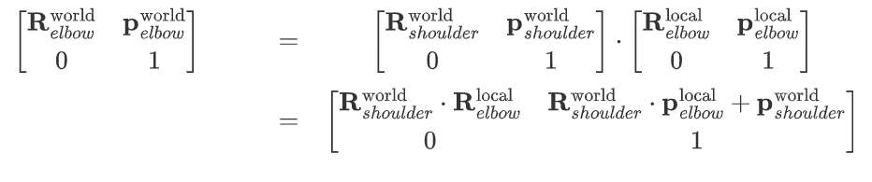
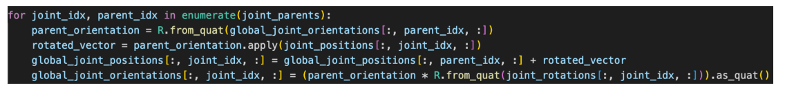
Review on Assignment 1 (part 2)
The computation
Compose the “local transform” matrix in TRS order (BVH format don’t have scale so we skip it)
Bring this “detailed” version of transform matrix into out formula:

Slide 6
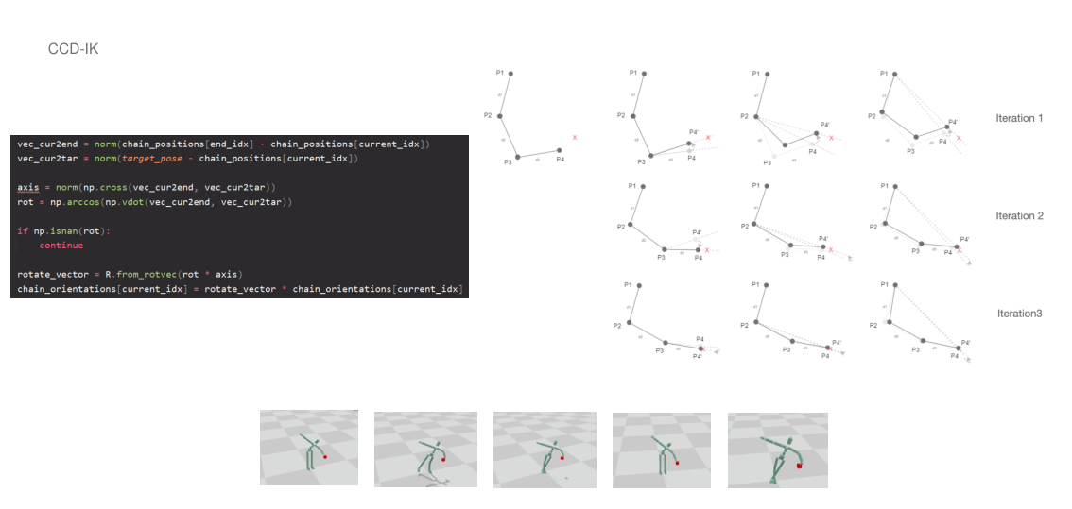
Review on Assignment 1 (part 3)

Slide 7
Review on Assignment 1 (part 3)
https://drive.google.com/file/d/1NivTs93H0zGLK4KA2HKo6Q5HxgeVXqCU/view?usp=drive_link

Slide 8
Review on Assignment 1
We now have some basic knowledge about motion data
Let’s dive deeper to actual animation processing

Slide 9
Tutorial 3
Temporal Editing of motion data
1. Rotation interpolation
2. Make smooth transitions

Slide 10
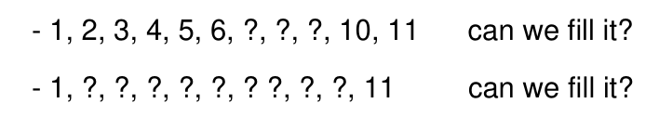
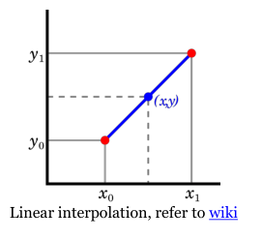
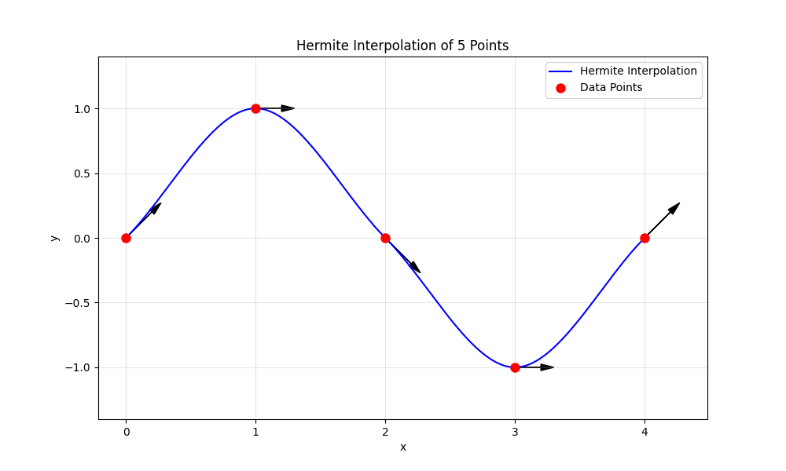
Tutorial 3
Rotation interpolation
The idea of “interpolation”
Hermit interpolation

Slide 11
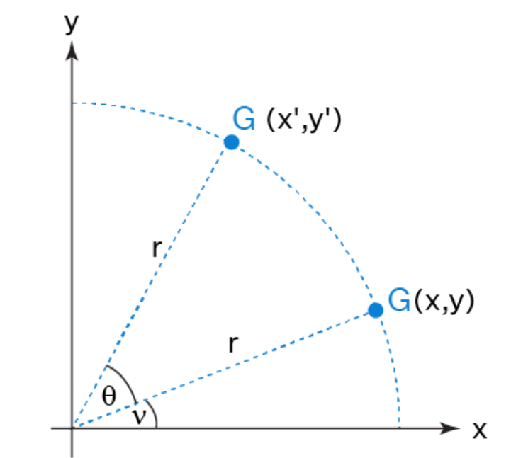
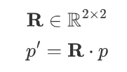
Tutorial 3
Rotation interpolation
How to interpolate rotations?
Understand rotations
Matrix multiplication in algebra
A11
A01
An intuitive process in geometry
Rotation in 2D

Slide 12
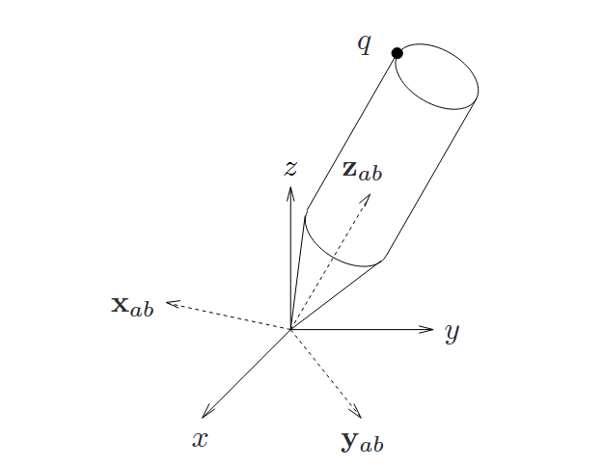
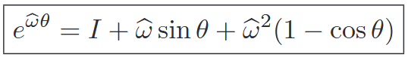
Tutorial 3
Rotation interpolation
Geometry understanding of 3d rotation
Rotate an object around a given rotation axis for certain angle
To connect it with algebra, let’s introduce Rodrigues’ formula
Matrix mapped from rotation axis
The rotation angle
The rotation matrix
Reference: A Mathematical Introduction to Robotic Manipulation

Slide 13
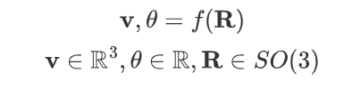
Tutorial 3
Rotation interpolation
The “in-between” state of rotation
Let’s decompose a rotation matrix into rotation axis and rotation angle through Rodrigues’ formula
A11
A01
Rotation in 2D
Interpolate the angle \theta
Interpolate the angle \theta

Slide 14
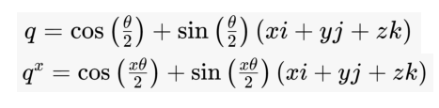
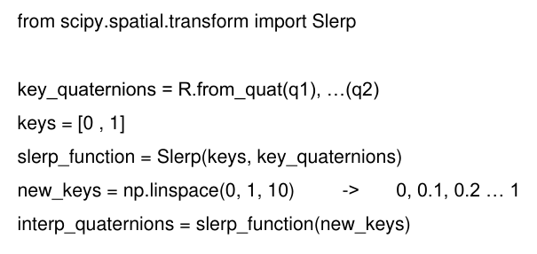
Tutorial 3
Rotation interpolation
It’s called “slerp”
Connection between rotation axis \bold{v}, rotation angle \theta and quaternion
Interpolate the angle of course gives us the following expression:
You can use scipy to perform it:

Slide 15
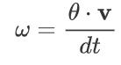
Tutorial 3
Rotation interpolation
Slerp and angular velocity
Angular velocity is given through a rotation axis and the speed rotation angle changes
Let’s decompose a rotation matrix into rotation axis and rotation angle through Rodrigues’ formula
Imagine this rotation process takes time dt, we can express the average angular velocity during the rotation

Slide 16
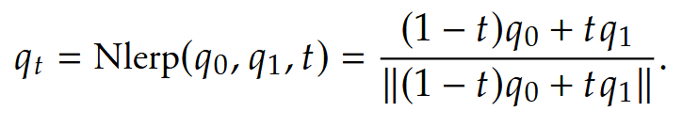
Tutorial 3
Rotation interpolation
There are more than one “correct” interpolation method
What if we directly use linear interpolation to quaternions ?
How’s this different from slerp, what problem would this brings?
1. If \theta is small, the difference is insignificant
2. The “in-between” rotations are not sampled at steady angular velocity, the rotation axis also shift a little.

Slide 17
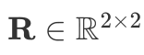

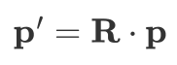


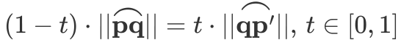


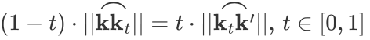
Tutorial 3
Rotation interpolation
A property
Given 2d rotation matrix and a point , define . Imagine the process of rotation as drawing an arc , pick a point from the arc s.t. . If we define the rotation matrix drawing the arc as , please prove the following equation:
Does this property hold in 3d space?
You can imagine this with the geometry model

Slide 18
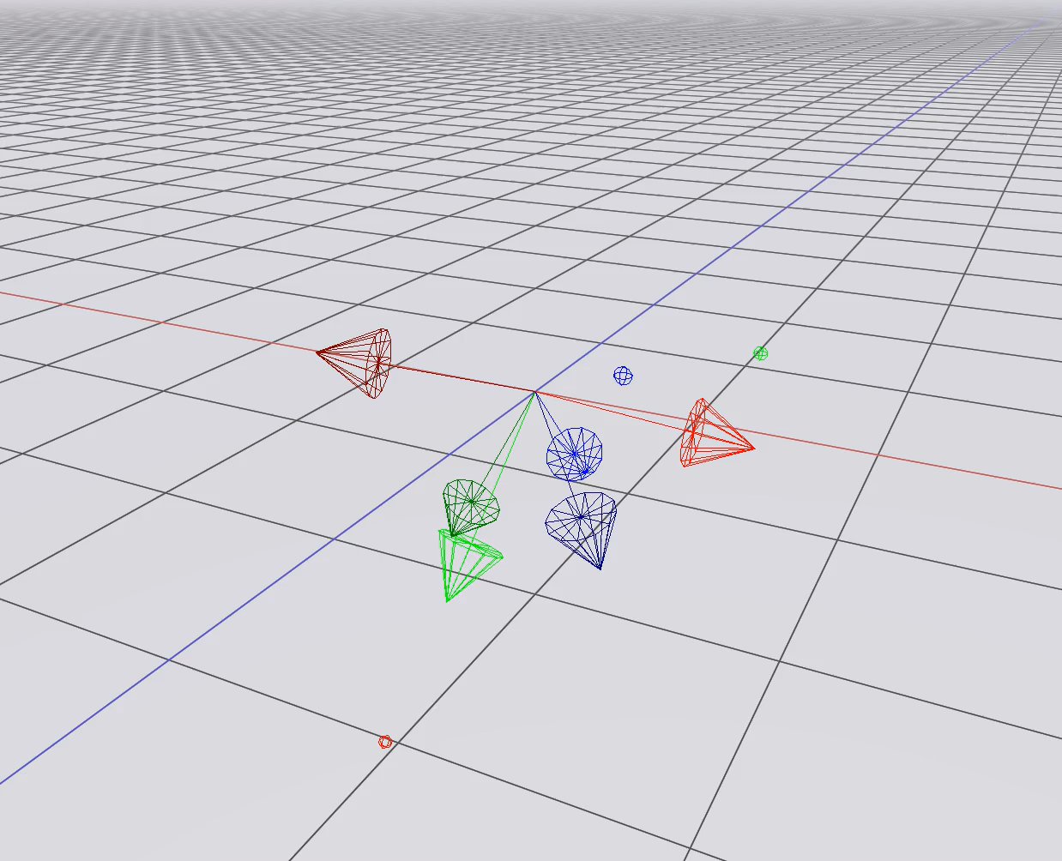
Tutorial 3
Rotation interpolation

Slide 19
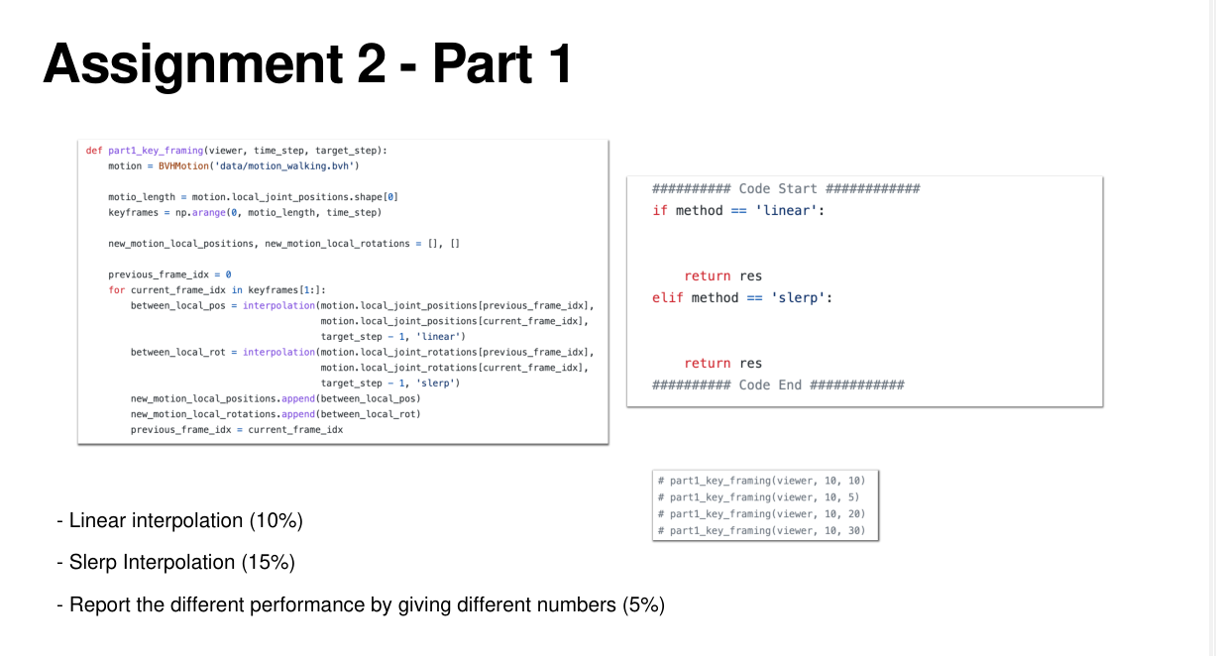

Slide 20
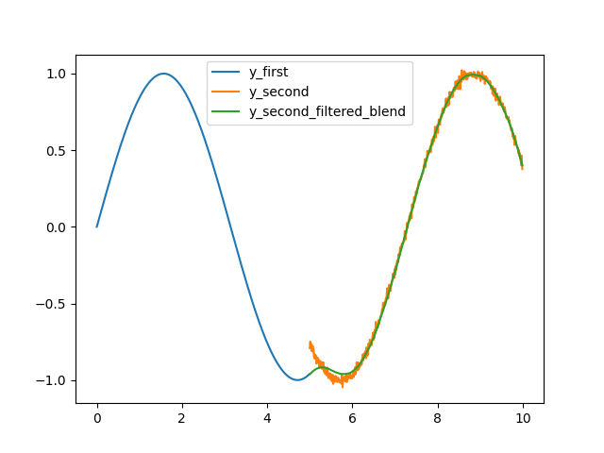
Tutorial 3
Make smooth transitions
What is a smooth transition?
We want to transition “movement” of the blue curve to the orange curve
Through a spring damper inertializer, we can get the green curve

Slide 21
Tutorial 3
Make smooth transitions
https://drive.google.com/file/d/1JhOeGfDGR6nq0cPAnsGe2s-q77aUKhNG/view?usp=sharing

Slide 22
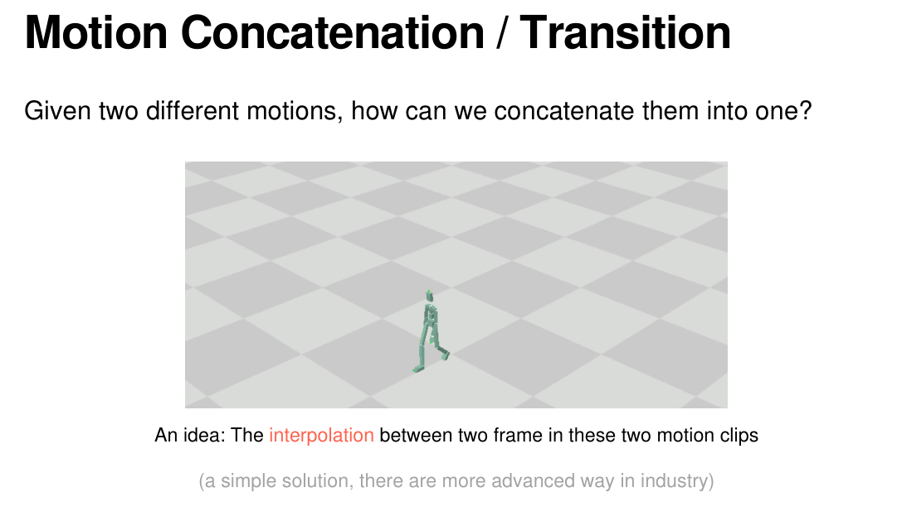
Tutorial 3
Make smooth transitions

Slide 23
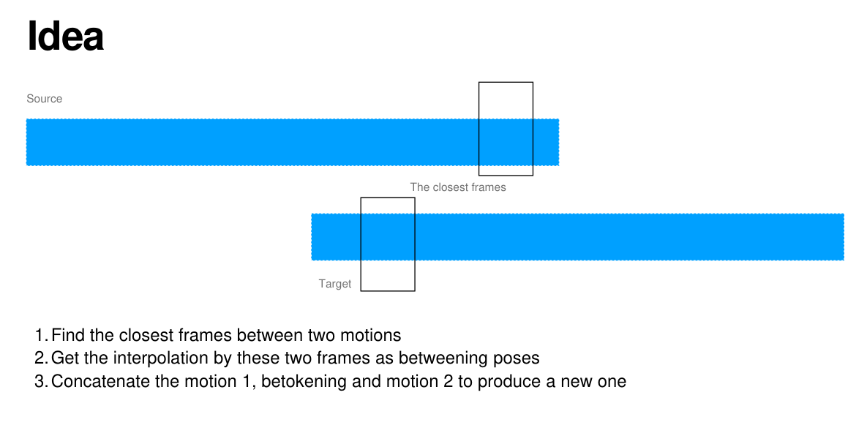
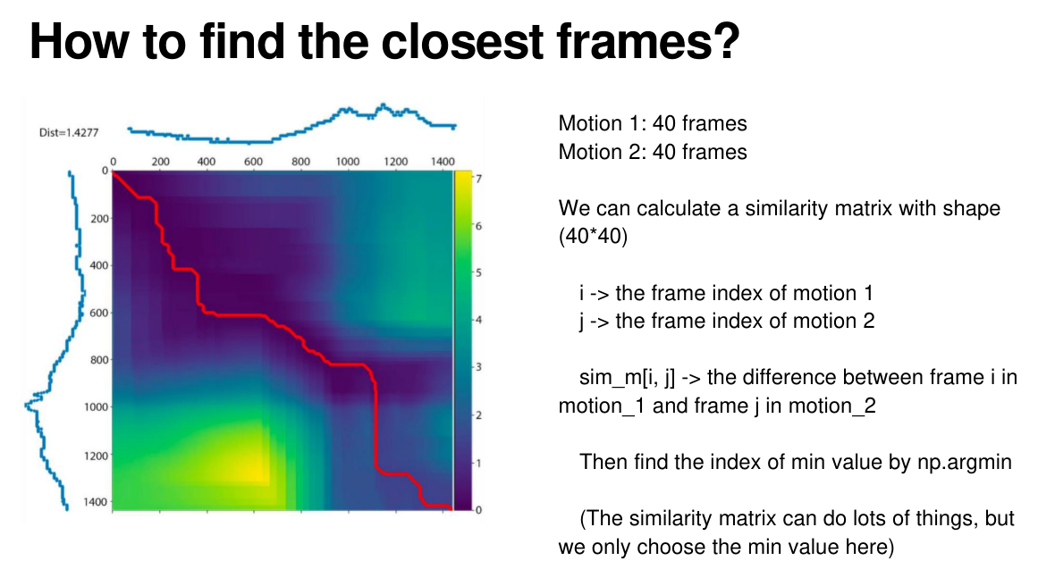
Tutorial 3
Make smooth transitions
A simple solution

Slide 24
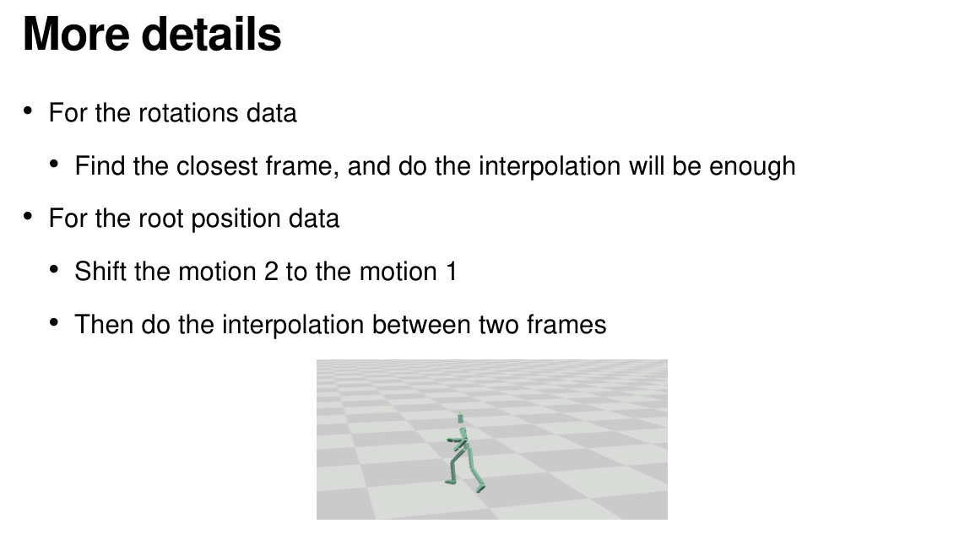
Tutorial 3
Make smooth transitions
A simple solution

Slide 25
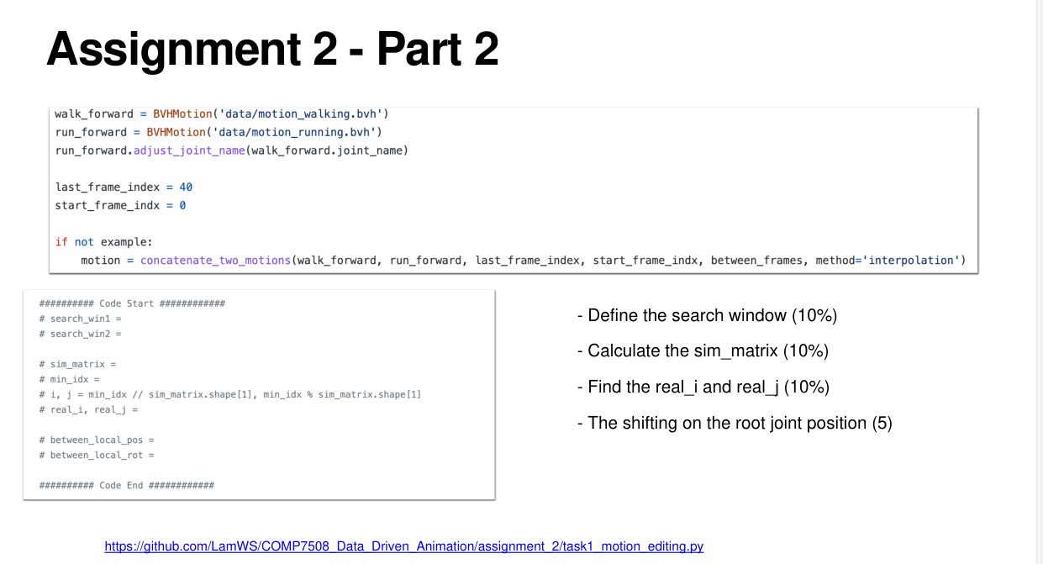

Slide 26
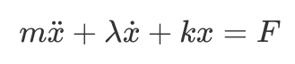
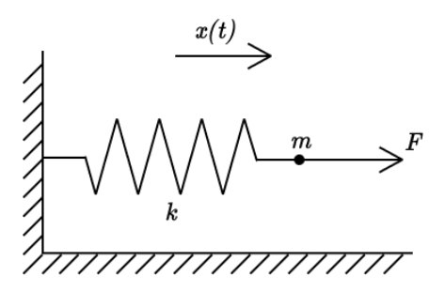
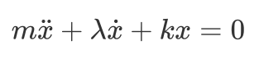
Tutorial 3
Make smooth transitions
A solution with better quality (mostly)
Use spring damper to make smooth transitions:
We only focus on the condition when there’s no external force. Solve the following ODE:

Slide 27
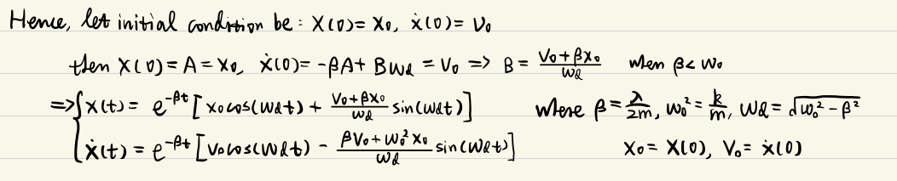
Tutorial 3
Make smooth transitions
Spring damper analytic solution
Treat the “difference” of position and rotation as “x”, use ending velocity (angular velocity) as “v”
Use spring damper to decay the offset smoothly, make smooth transitions.

Slide 28
Tutorial 3 (Q & A)
https://drive.google.com/file/d/1cHf2FQbp0mGnkjxuvh2cORAI0gZGLGDz/view?usp=sharing

